Slide 1
BlACKTECH’S PIZZA BUSINESS INTELLIGENCE REPORT BY OREOLUWA R. OLOYEDE

Slide 2
pizza project
BUSINESS INTELLIGENCE OBJECTIVES | METRICS | LEVEL OF DETAIL
TO INCREASE ORDERS | TOTAL ORDERS | DATE( QUARTER, MONTH, DAY) PIZZA TYPE, CATEGORY, SIZE
TO INCREASE REVENUES | TOTAL REVENUE | DATE( QUARTER, MONTH, DAY) PIZZA TYPE, CATEGORY, SIZE
UNDERSTANDING CUSTOMERS’ PURCHASE BEHAVIOUR | AVERAGE ORDER VALUE | DATE, MONITORING PEAK PERIODS
TO IMPROVE PRODUCTIVITY | TOTAL ORDERS | DATE
TO DETERMINE SALES PERFORMANCE OF PIZZA (BEST SELLING AND LEAST SELLING) | TOTAL ORDERS TOTAL REVENUE | PIZZA TYPE, CATEGORY, SIZE

Slide 3
Data tables modelling
Table name | type | Primary key | Foreign key
orders | Dimension / Lookup | Order_id
Pizza_types | Dimension / Lookup | Pizza_type_id
Order_details | Fact / Data | Order_details_id | Order_id. Pizza_id
Pizza | Fact / Data | Pizza_id | Pizza_type

Slide 4
DATA MANIPULATION
A total of five tables were provide (pizzas, pizzas_type, orders, order_details, data_dictionary), all in csv format.
The provided data were diligently inspected for errors using excel and SQL.
Data transformation (joining of tables) and visualization were carried out using BI tools.

Slide 5
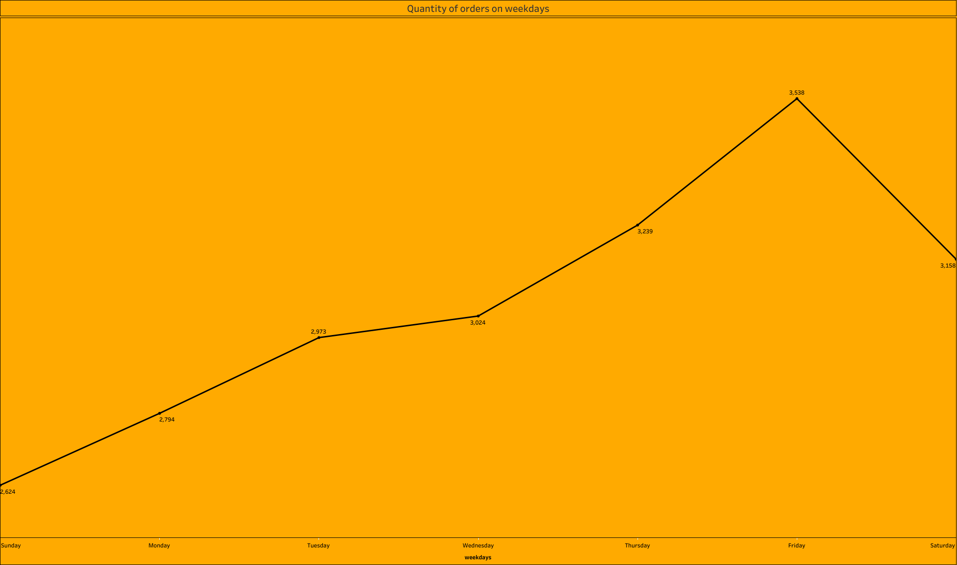
Weekday with highest orders:
Friday
Weekday with lowest orders:
Sunday

Slide 6
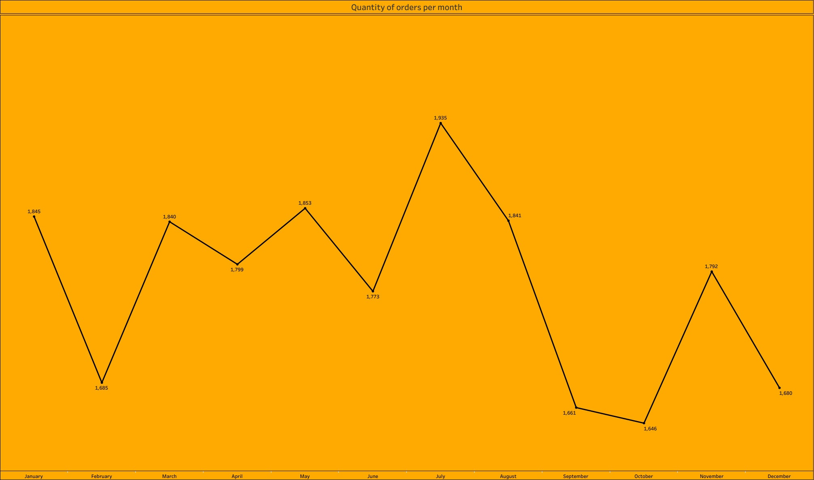
Month with highest orders:
July
Month with lowest orders:
October

Slide 7
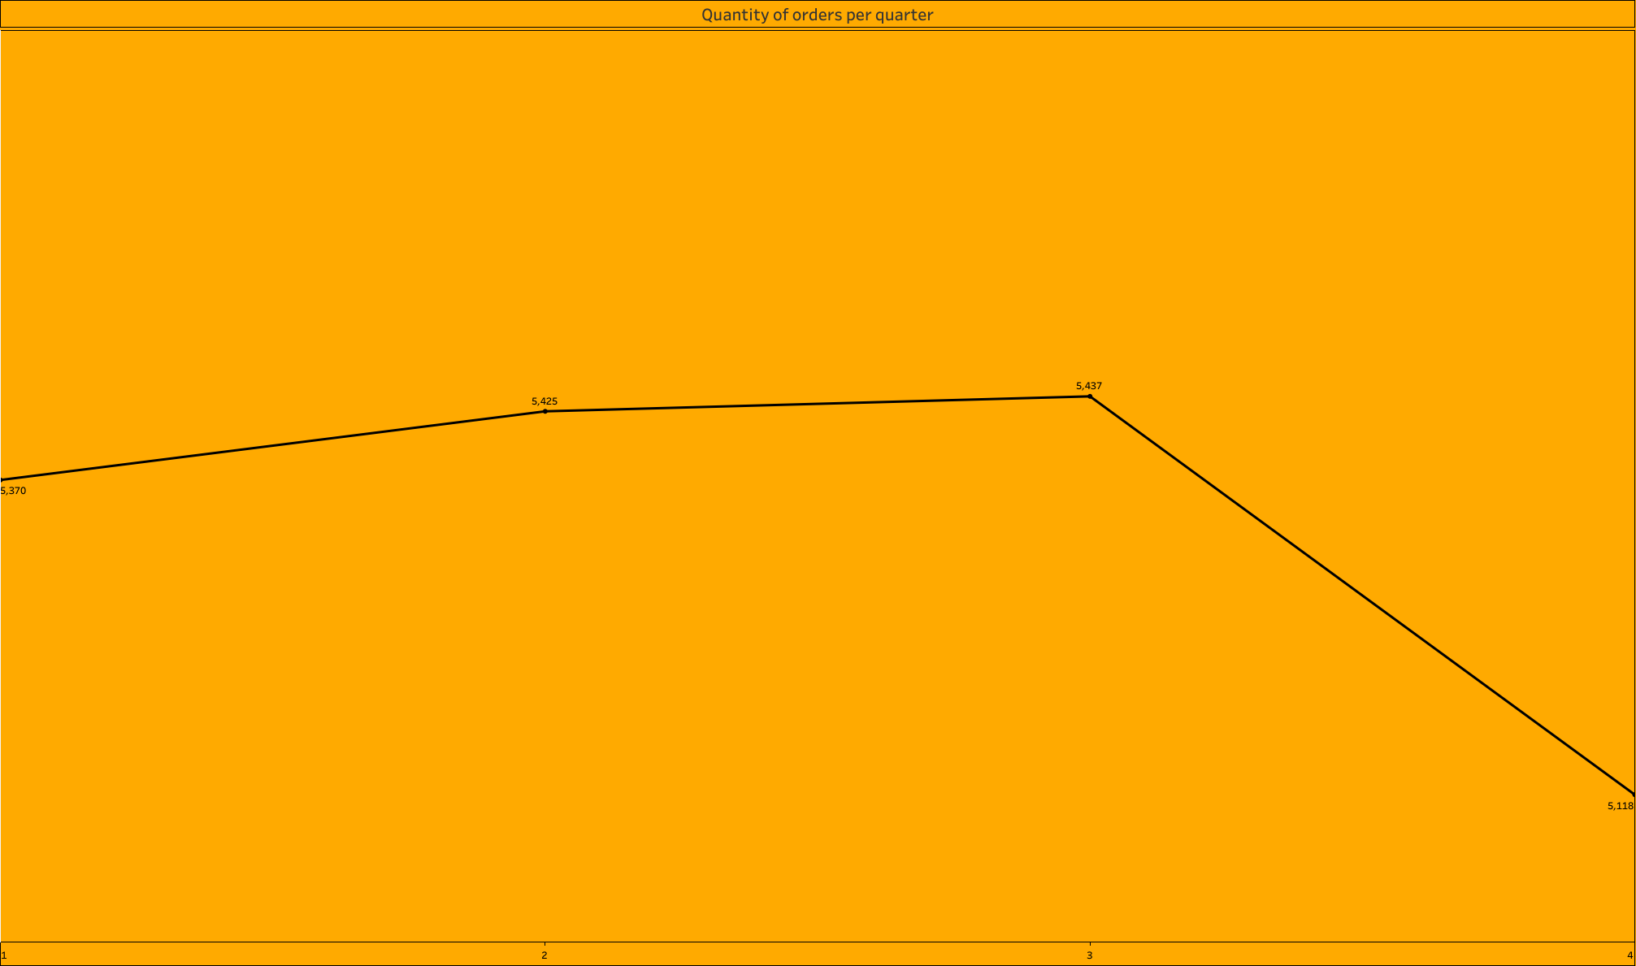
The Third quarter of the year has the highest orders
The fourth quarter of the year has the lowest orders

Slide 8
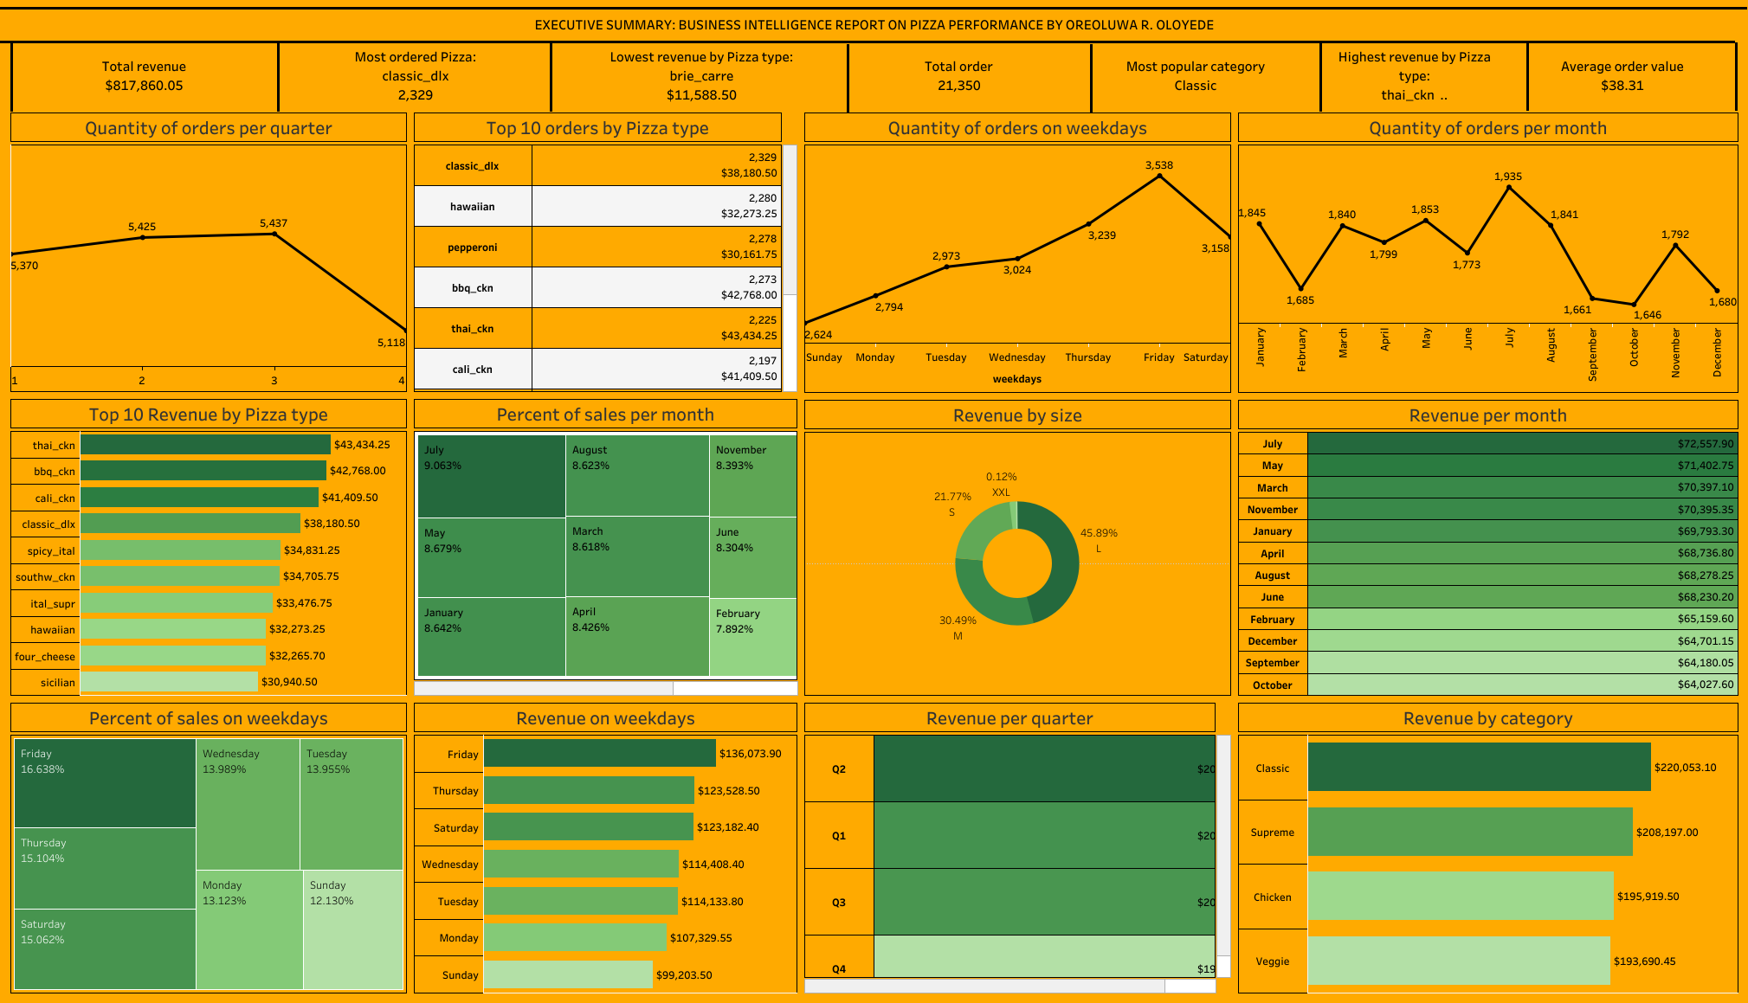

Slide 9
RECOMMENDATION FOR THE BUSINESS OBJECTIVES
The best selling category (classics) production should be increased while the least selling category (Veggie) should be decreased to maximize efficiency and reduce waste.
Seasonal pricing discount should be implemented to maximize productivity on days with low orders
Advertise more in months with possibility of high demands
Increase production of top 10 Pizzas with highest sales
Lower production of XXL and L sizes due to possibility of low demands
Increase production on Fridays, as more customers equally means more sales
On days of predicted low orders, lower number of staffs should be available

